Slide 1

NARROW LINKS
---Shorten your link with ease
and share your link via SMS or scan QR code
MADE BY:
UNNIKRISHNAN
GAURAV BHANDARI

Slide 2


ABOUT THE PROJECT
This project is an attempt to make a URL Shortener Service(Narrow-Links):
it creates a short, unique URL that will redirect to the specific website of the user's choice.
It is secure and has the HTTPS protocol and data encryption.

Slide 3

WHY IT WAS NEEDED?
THIS Project helps when someone wants to share a link or include a link in their profile, they can. There are times when that link is too long and takes up the entire space as well as a lot of characters, which is a problem when there are only a limited number of characters to type.
As a result, our project solves the problem. We shorten those long URLs and provide a copy button to quickly copy the short URL.

Slide 4
Features and advantages of Narrow links
FEATURES
ADVANTAGES
It reduces the size and length of the long gusty URLs
Easy to share short links with COPY LINK button available.
It can also Converts the link in QR code.
Links can also be shared via SMS
Shortens your long links address
It uses less number of characters
Good for memory management
Makes code small with less number of lines
It makes the code more understandable and readable.

Slide 5
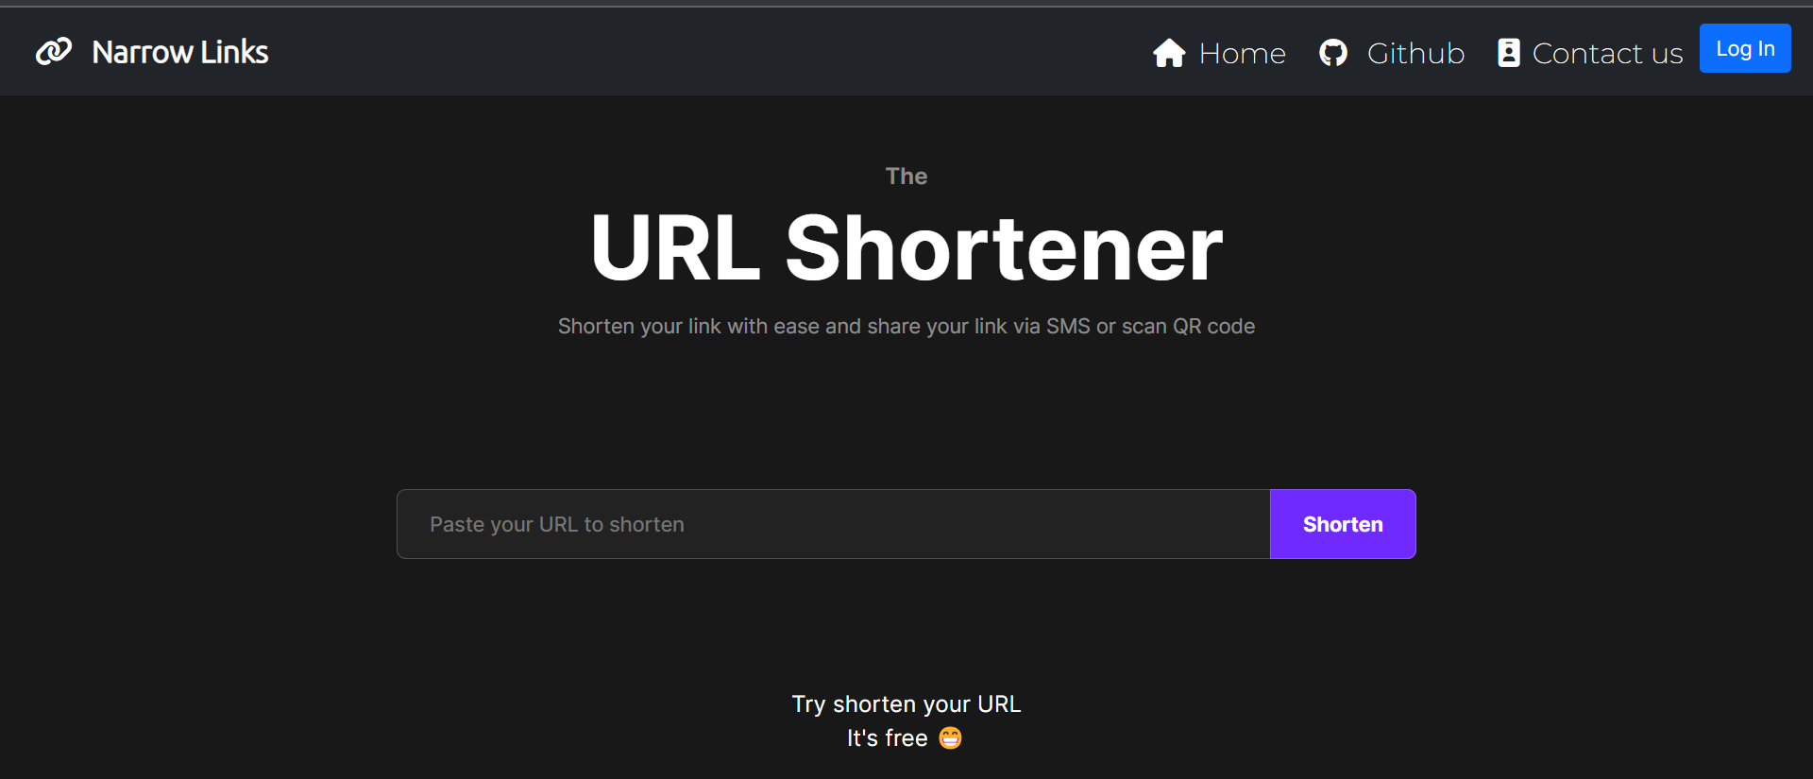
HOME PAGE

Slide 6
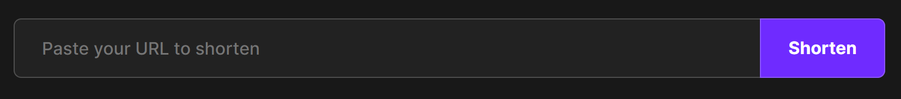
HOW IT WORKS
The main ojective of the app is to help to reduce long Urls and links into short URLs so that it becomes easier to share it with others.
Step 1 : Go to the input field and enter any URL you want to shorten

Slide 7
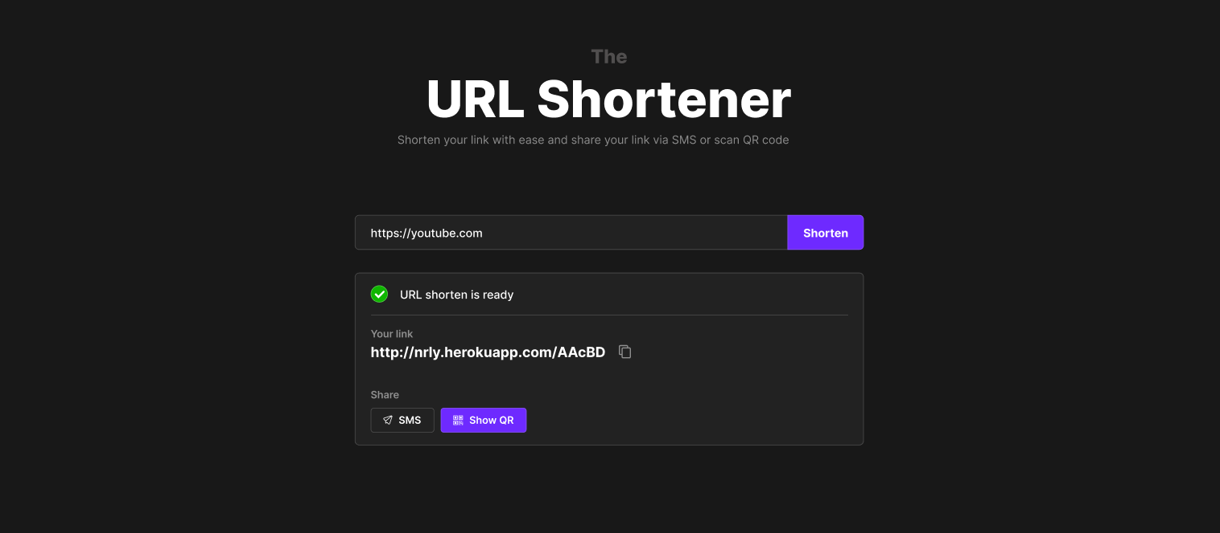
Step 2 : Enter the Shorten button to shorten the URL
Step 3 : The Shortened URL will be now shown below the input field which you can copy and share.

Slide 8
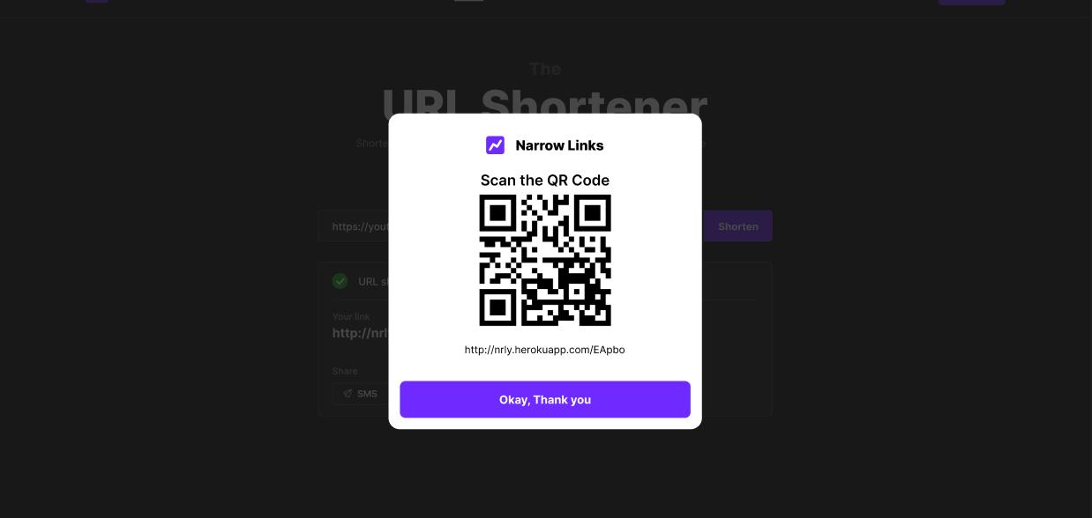
Step 4 : You can also generate the QR code for the URL using the Show QR button.

Slide 9
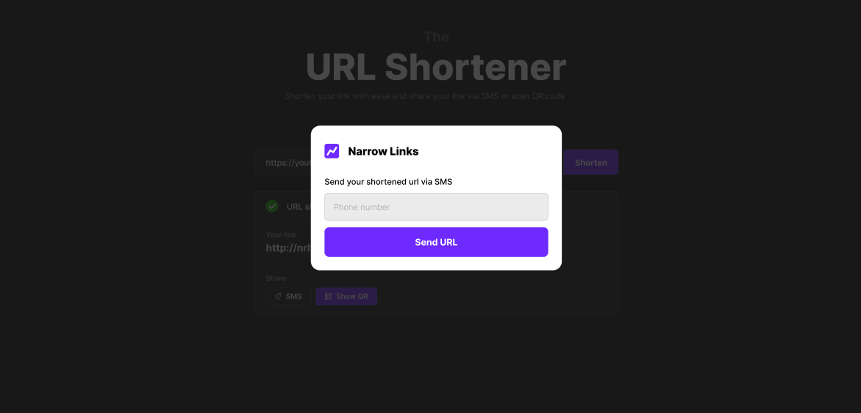
Step 5 : You can also easily share the URL to someone as an sms into their phone number using SMS button below the shortened URL

Slide 10
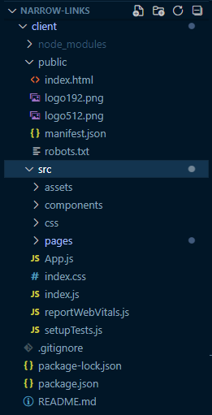
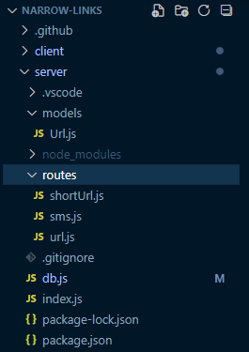
FOLDER STRUCTURE
Client Side folder Structure
Server Side folder Structure

Slide 11
DIFFERENT COMPONENTS OF THE APPLICATION
CLIENT SIDE
Firstly we have created a frontend design for our website. Since we have used React Library for frontend, we have used component based architecture to design the frontend. We built different components of the app independently and saved every component in different files. By doing this if any time the crashes it is easy for us to debug and find out in which file has the error happened.
We have created components for Navbar, Input & Output field, QR code dislplay etc.

Slide 12
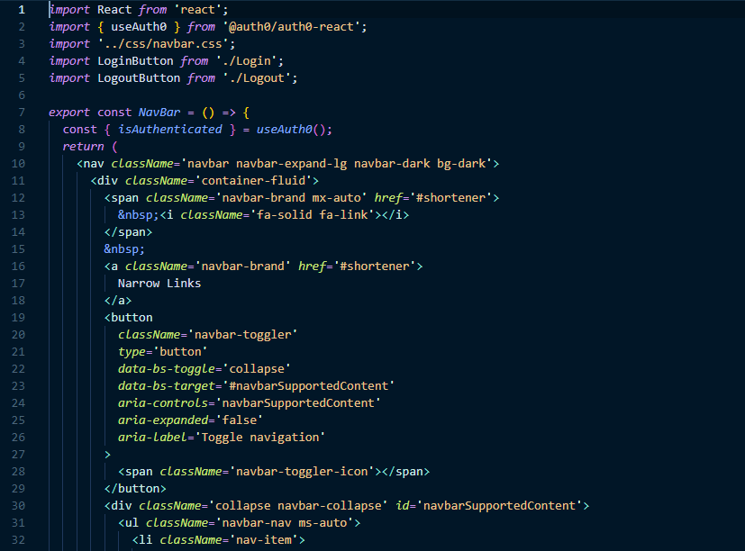
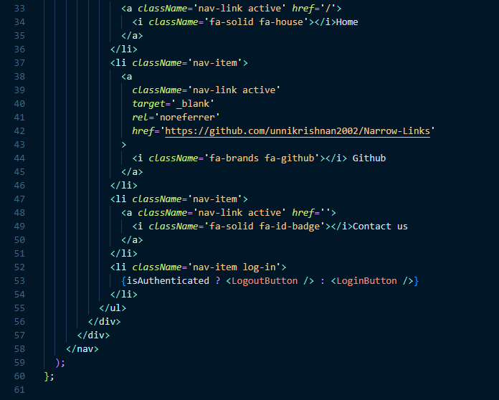
Navbar component

Slide 13
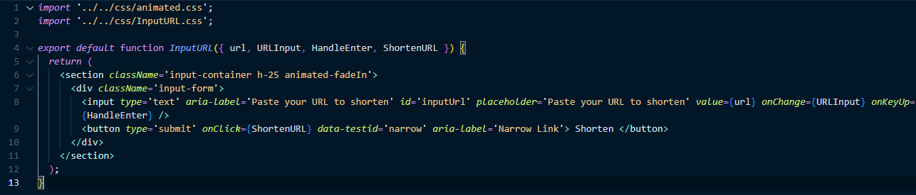
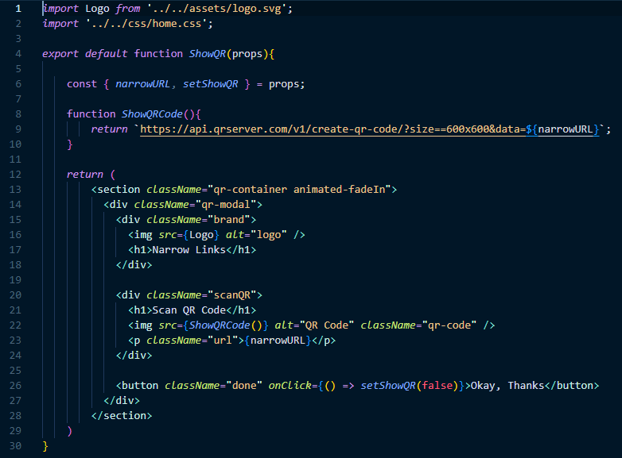
Input component
QR component

Slide 14
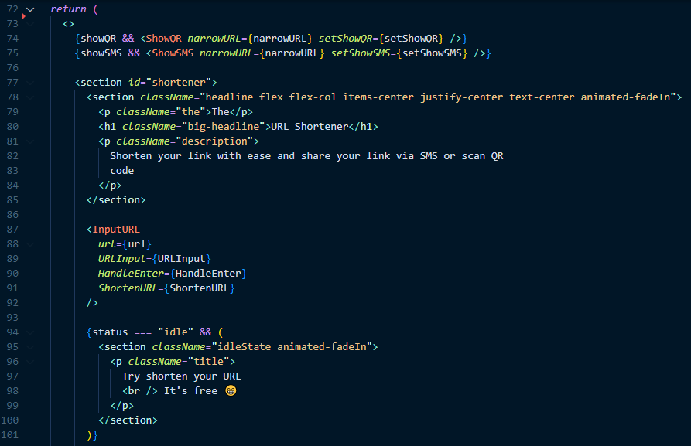
Finally we have integrated all this components to the home page

Slide 15
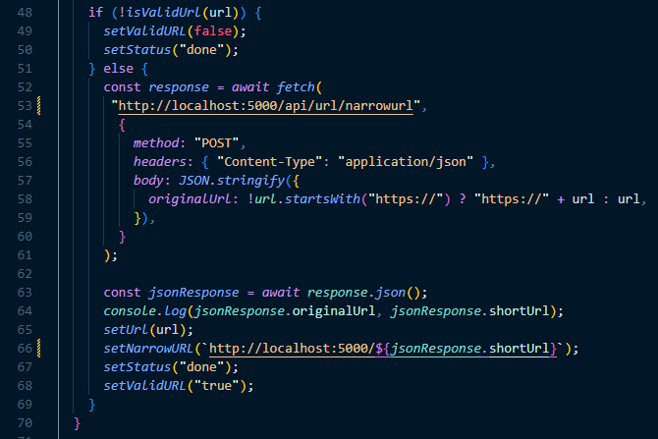
After designing the UI now it was time to connect our backend API to the frontend. We have used fetch method to connect with our backend API and receive the response
Calling the API using fetch method
Receiving Json response

Slide 16
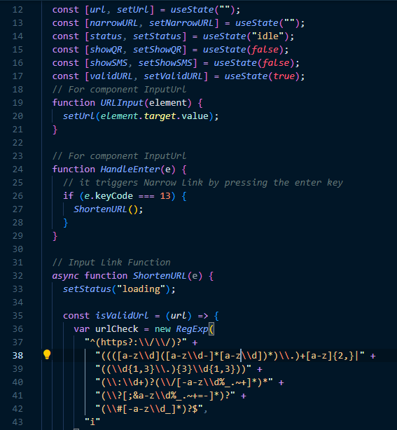
Finally we are going to populate the backend data to frontend and display them as output.
Here we have used useStates which is a concept of react to update value of variable in the running state
Finally we used handlers and function to do operations and handle clicks etc

Slide 17
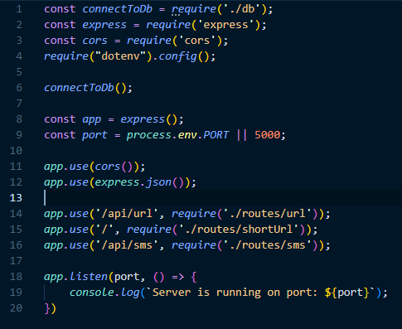
SERVER SIDE
In server side we are using Node.js which encourages file based routing and makes it easy to organise the file structure and easy error detection.
The server is responsible for storing the data and has all the code for the functionality of the app
Firstly we created the index.js which is the entry point of our backend and defined the necessary routes.

Slide 18
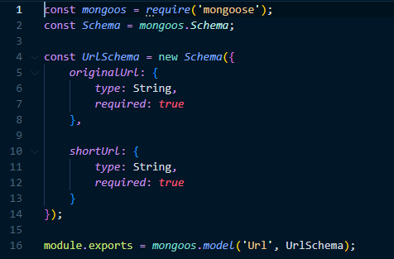

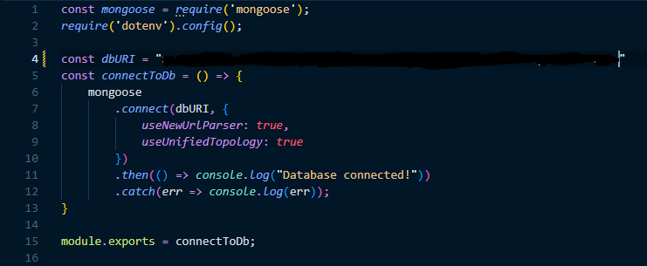
Then we created a Model Schema to store all the URLs in our database so that we can perform necessary operations on them
After that we create necessary routes to add the functionality. We separated each functionality in different files so that we can call different routes to carry out different functions
Finally we connected our backend to the database to store the data

Slide 19
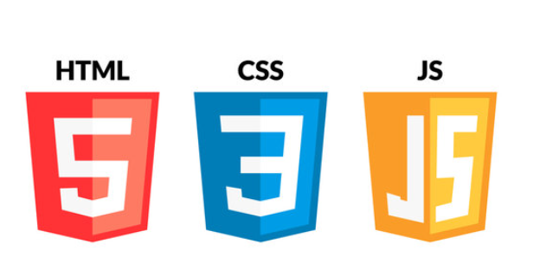

Slide 20


Technolgies Used
Node.js
Node. js (Node) is an open source, cross-platform runtime environment for executing JavaScript code.
Node is used extensively for server-side programming, making it possible for developers to use JavaScript for client-side and server-side code without needing to learn an additional language.
The website’s backend is built using Node.js. Node has many in built functions for doing many backend operations in a simple way. Node.js helps us to understand and code many complex functions in the backend
React.js
The React. js framework is an open-source JavaScript framework and library developed by Facebook.
It's used for building interactive user interfaces and web applications quickly and efficiently with significantly less code than you would with vanilla JavaScript
The website’s frontend interface is built using React library. React makes it simple to use component based architecture which makes it easier to design independent components in the frontend

Slide 21
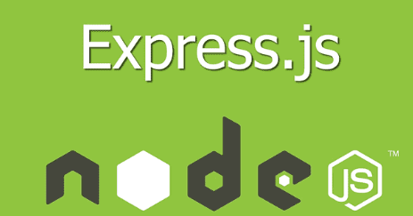

MongoDB
MongoDB Atlas is a fully-managed cloud database that handles all the complexity of deploying, managing, and healing your deployments on the cloud service provider of your choice (AWS , Azure, and GCP).
MongoDB Atlas is the best way to deploy, run, and scale MongoDB in the cloud.
Express.js
Express is a node js web application framework that provides broad features for building web and mobile applications.
It is used to build a single page, multipage, and hybrid web application. It's a layer built on the top of the Node js that helps manage servers and routes.

Slide 22

Bootstrap
What is Bootstrap used for?
Bootstrap is a free, open source front-end development framework for the creation of websites and web apps.
Designed to enable responsive development of mobile-first websites, Bootstrap provides a collection of syntax for template designs.
Most of the frontend components are made using bootstrap templates which makes it easier to design components even faster and customise according to your choice

Slide 23

API (Application Programming Interface)
Application Programming Interface (API) is a software interface that allows two applications to interact with each other without any user intervention. API is a collection of software functions and procedures.
API is defined as a code that helps two different software’s to communicate and exchange data with each other.

Slide 24


Twilio SMS API
Twilio's SMS API helps you send and manage messages programmatically: To send an outbound SMS, WhatsApp, or Channels message with the API, POST to the Message resource. You'll also use the Message resource to fetch messages and list messages associated with your account.
The SMS feature is in the website is implemented through this API
QR Code API
QR Code API is an application programming interface that you can integrate with your app or website to create customized QR Codes of your choice.
The QR code feature in the website is implemented through this API

Slide 25


HOPE YOU LIKED IT

